Slide 1



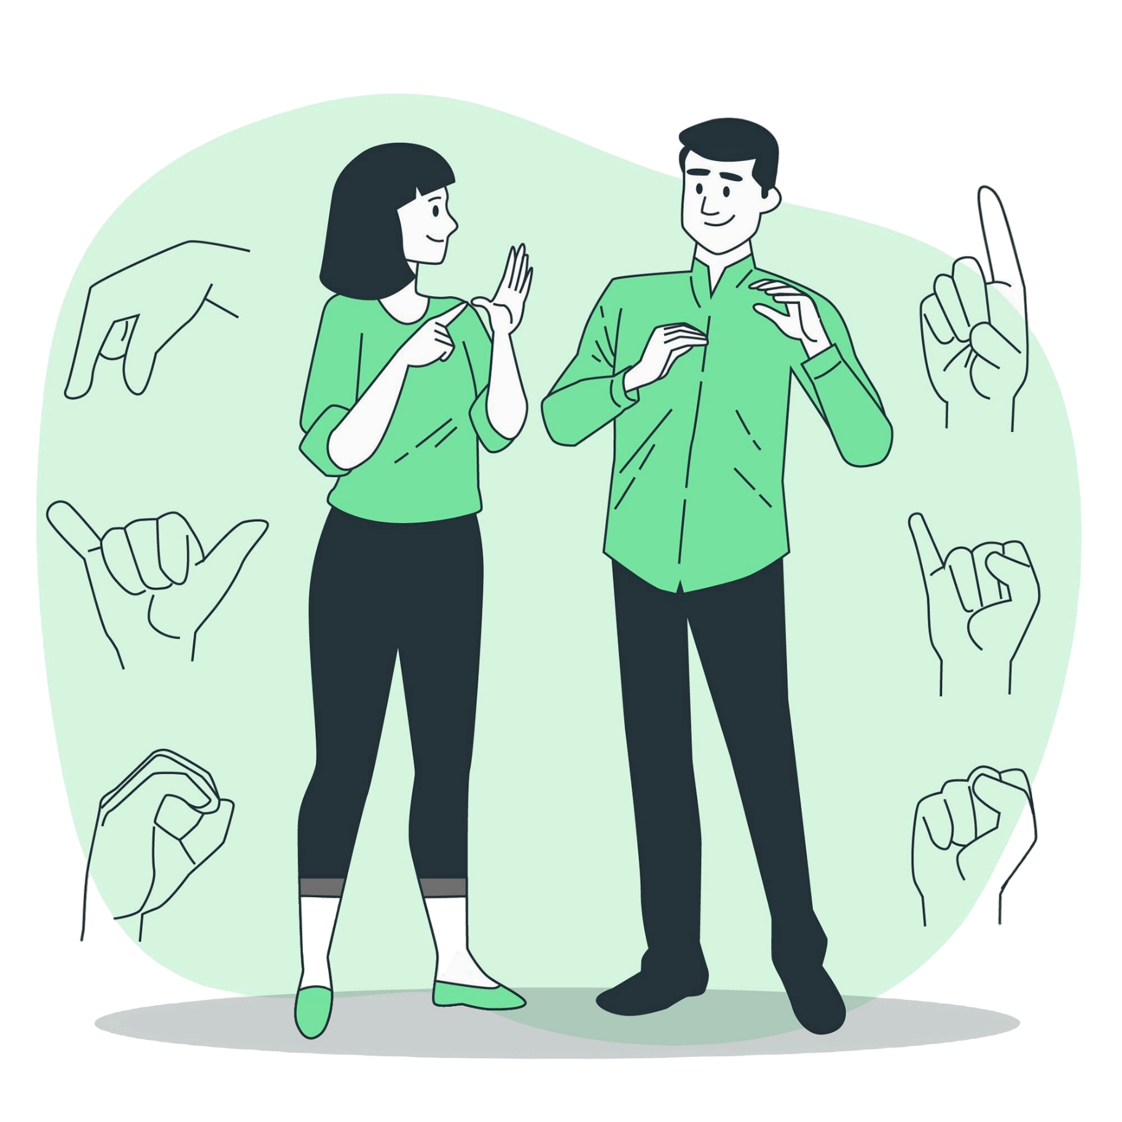



Sri Lankan Sign Language Mobile Application with Real-Time Motion Recognition
A Project by
Mr. K.N.S Grero
20200546/w1830258
Supervised by
Mr. Nathindu Himansha

Slide 2



Agenda
Problem Domain
Research Gap
Aim of the Project
System Design
Prototype Demonstration
Testing and Evaluation
Novelty
Limitations and the Future Enhancement
Conclusion
Notes:
2

Slide 3


Lack of robust, real-time sign language translation solutions: Develop a mobile app that facilitates accurate, real-time bidirectional SLSL translation using CNN-LSTM models and MediaPipe. (Manoj Kumar et al., 2020)
Problem Domain
Communication barrier for the deaf community in Sri Lanka: Communication barriers for the deaf community in Sri Lanka are due to limited translation resources for Sri Lankan Sign Language (SLSL)..
Existing apps focus on static gesture recognition rather than dynamic motion: Promotes social inclusion and offers a novel solution by addressing motion recognition and two-way translation gaps. (Gedaragoda et al.,2023)

Slide 4
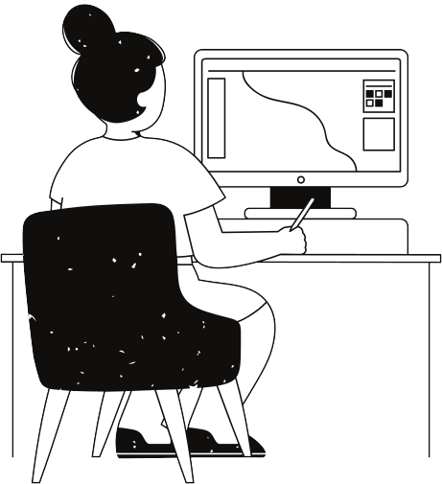
Problem Domain CONT.
​ Related work discusses the approaches
Wadhan: Emergency Communication Application for Speech and Hearing-Impaired Citizens(Dewasurendra et al., 2020)
A Static Sinhala Sign Language Translation Using Media-Pipe and SVM Compared with Hybrid Model of KNN, SVM and Random Forest Algorithms(Gedaragoda et al.,2023)
EasyTalk: A Translator for Sri Lankan Sign Language using Machine Learning and Artificial Intelligence. Manoj Kumar, D. et al. (2020)

Slide 5

Research Gap
Several limitations can be identified in magnetic resonance image analysis systems when investigating existing works.
Real-time motion recognition for dynamic gestures
Lack of two-way (bidirectional) translation between sign language and text
Limited SLSL datasets, resulting in low system generalizability

Slide 6
Project Aim
Develop a mobile application that translates SLSL in real time
Use of CNN-LSTM for dynamic gesture recognition
Bidirectional translation to support both sign-to-text and text-to-sign
Enhance social inclusion and communication for the deaf community

Slide 7
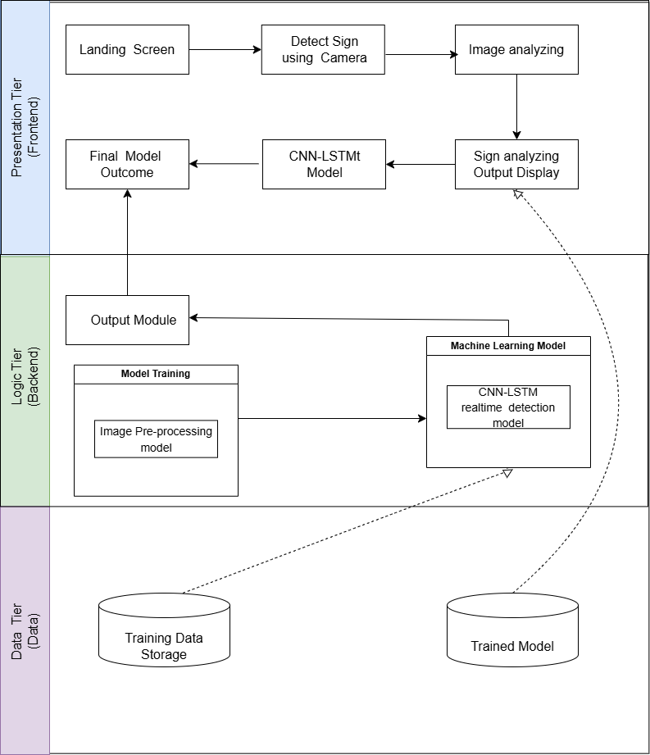
System Design

Slide 8
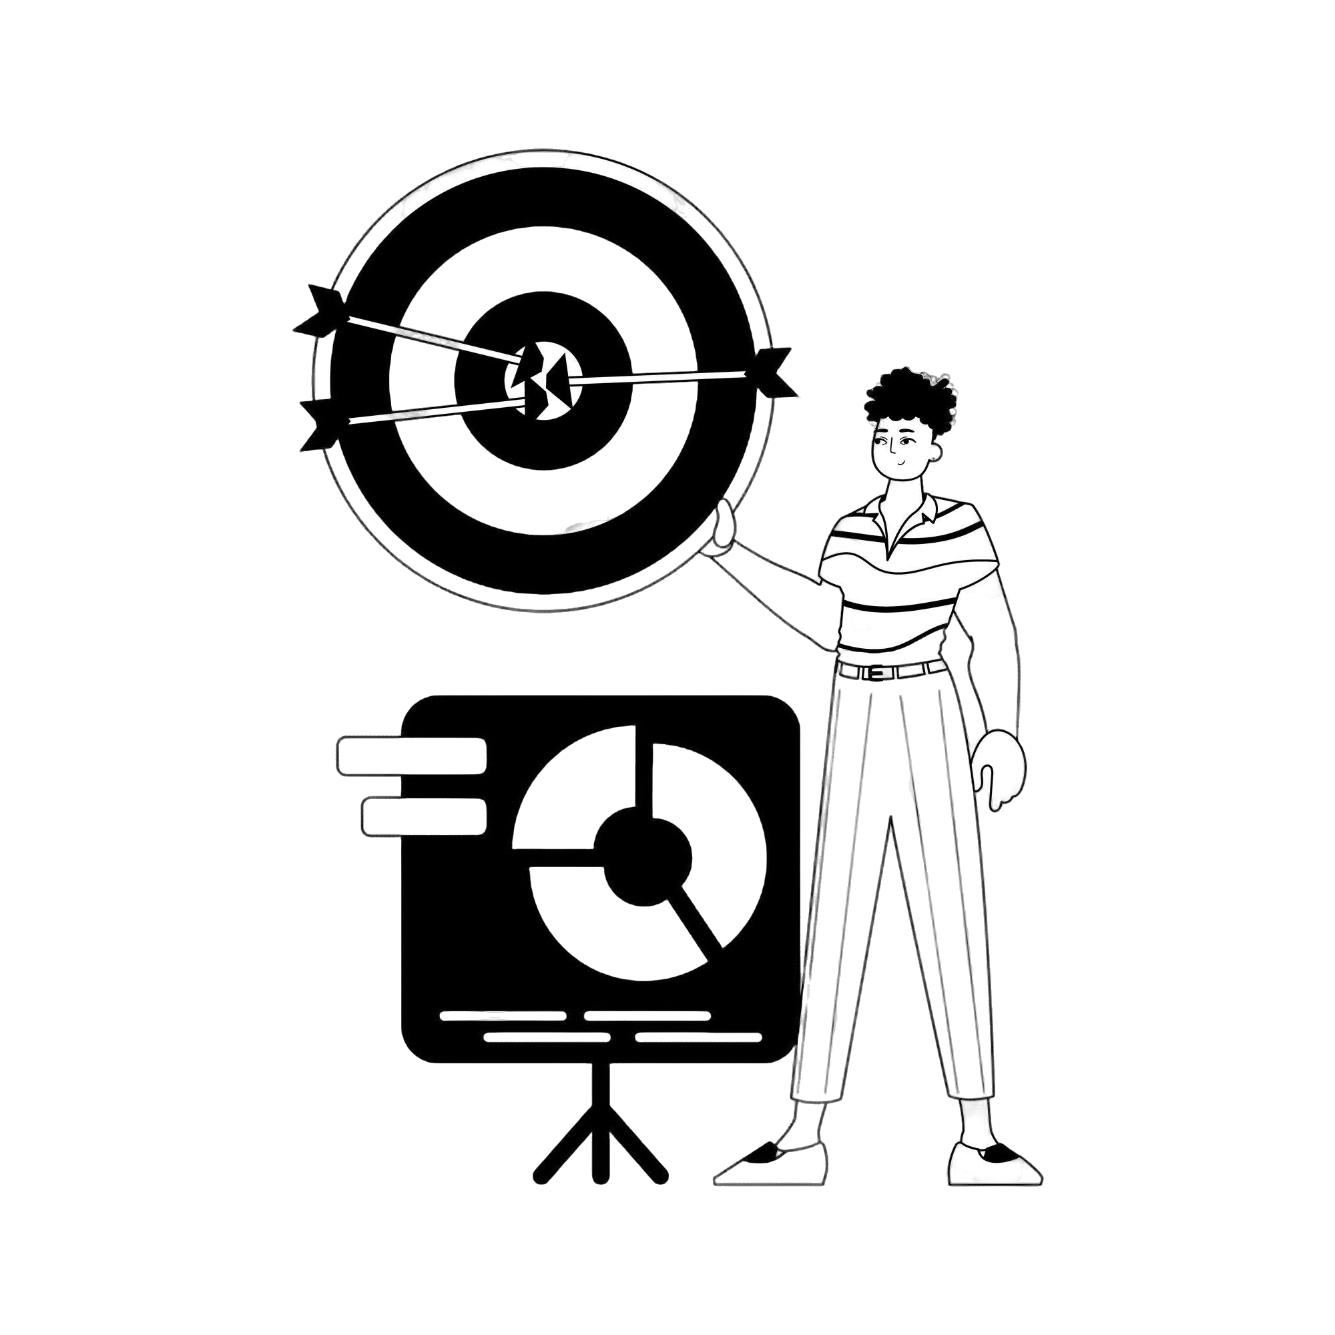

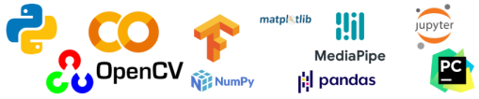

Technology Stack
Presentation Tier:
Logic Tier:
Data Tier:

Slide 9
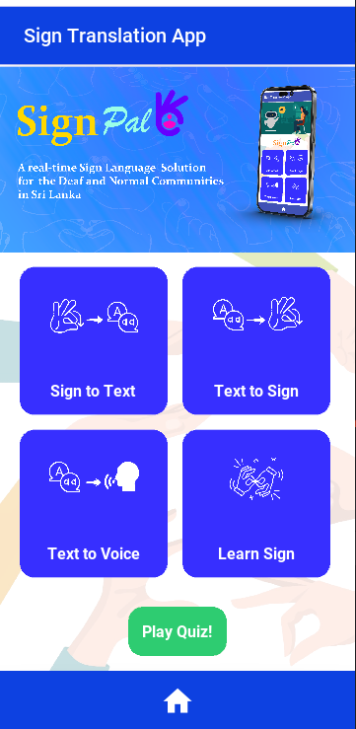
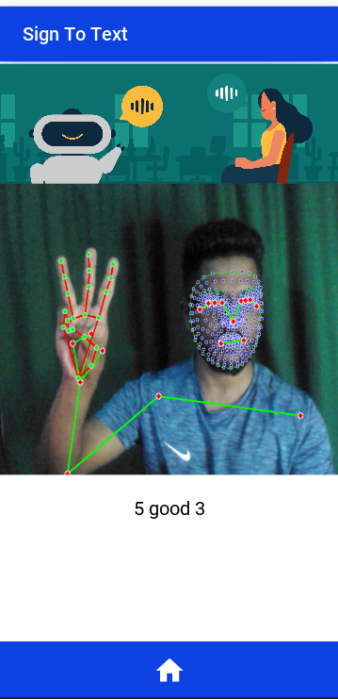
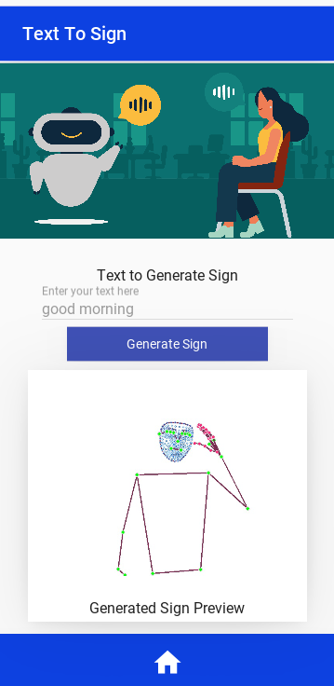
Prototype Demonstration
Key Features:
Sign to Text Translation
Text to Sign Translation
Notes:
9

Slide 10
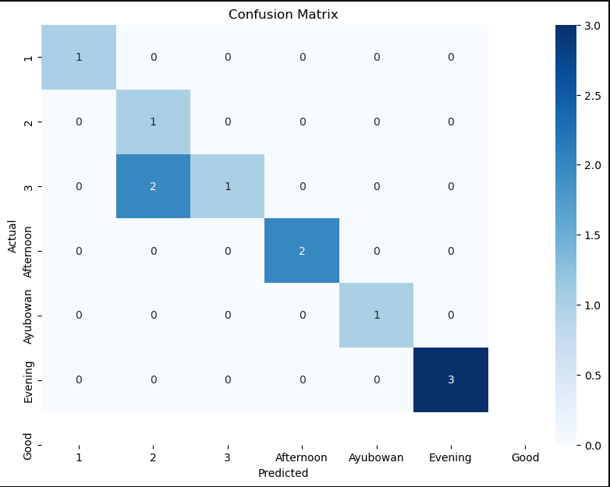
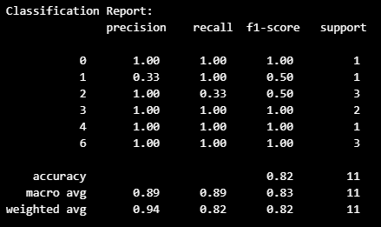
Testing and Evaluation
Functional Testing:
Achieved real-time accurate translations
Model Testing Metrics:
Accuracy, F1 Scores, Confusion Matrix, ROC Curve
Challenges:
The Lack of datasets and scarcity of labeled SLSL datasets was a major problem.
Optimizing the CNN-LSTM model for real-time performance on mobile devices.
Building a CNN-LSTM model to get better accuracy

Slide 11
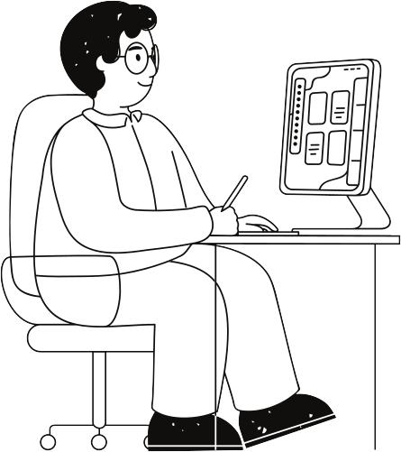
Novelty
Bidirectional Translation Capability
Rather than supporting only one-way translation (typically from sign to text), the system provides two-way conversion between text and sign language.
User-Centric Design for Social
The design of the mobile application prioritizes both accessibility and usability, with a user interface developed using KivyMD that caters to varying levels of technical proficiency.
Integration of Real-Time Dynamic Motion Recognition
previous approaches that primarily emphasize static gesture detection, this project uniquely integrates a CNN-LSTM model with MediaPipe to capture and interpret fluid.

Slide 12
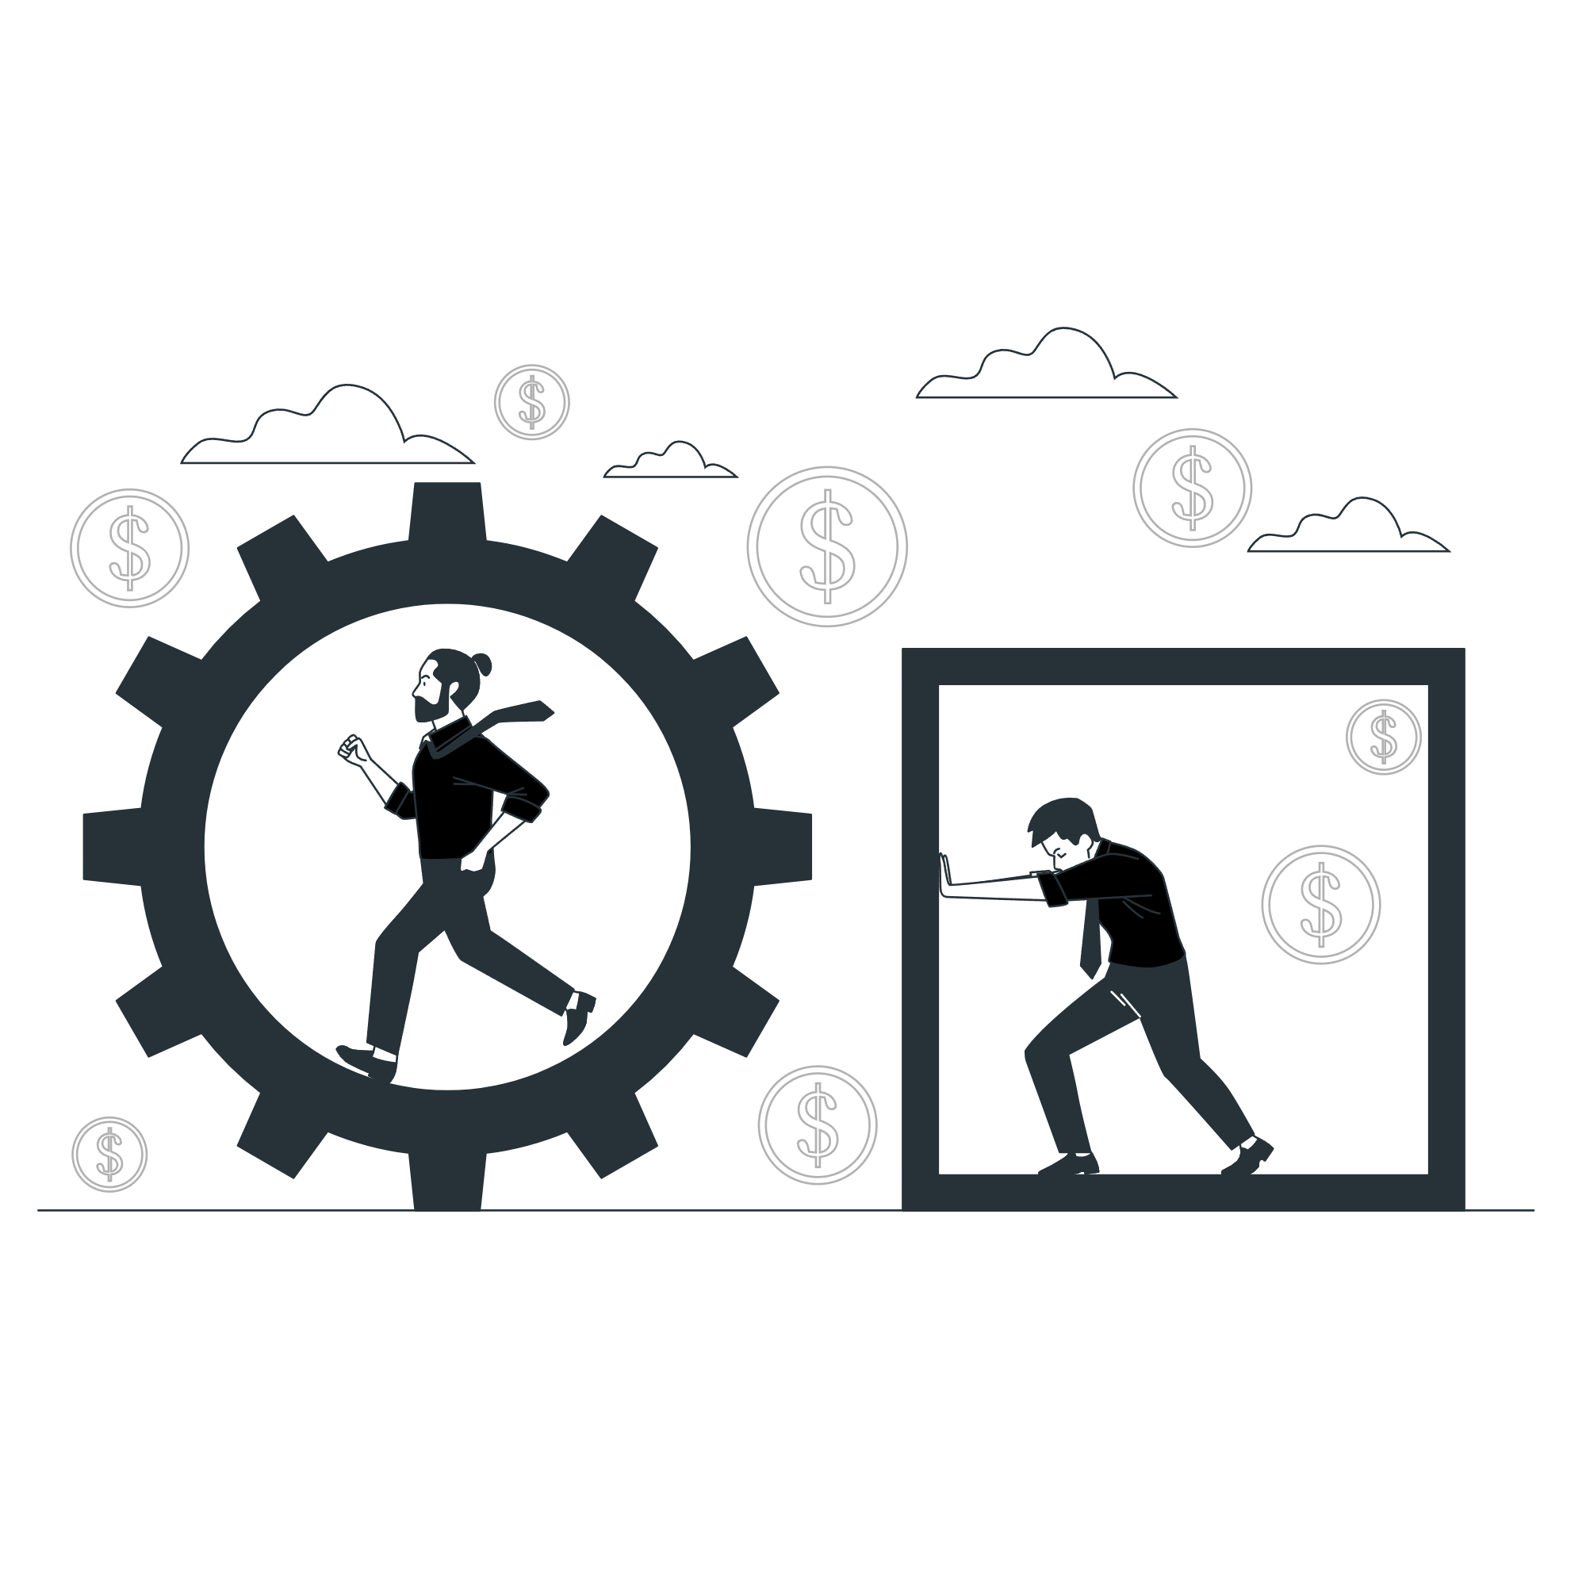
Limitations of the Project
Reduced classification performance in low-light
Challenges in distinguishing subtle motion variations (LSTM sequence issues)
Need more diverse SLSL datasets
Notes:
12

Slide 13
Future Enhancement
Expand dataset with additional SLSL gestures and regional dialects
Optimize mobile performance and latency
Integrate additional AI models (e.g., transformer architectures) and add features like animated avatars for text-to-sign
Incorporating animated avatars for text-to-sign translation
Notes:
13

Slide 14
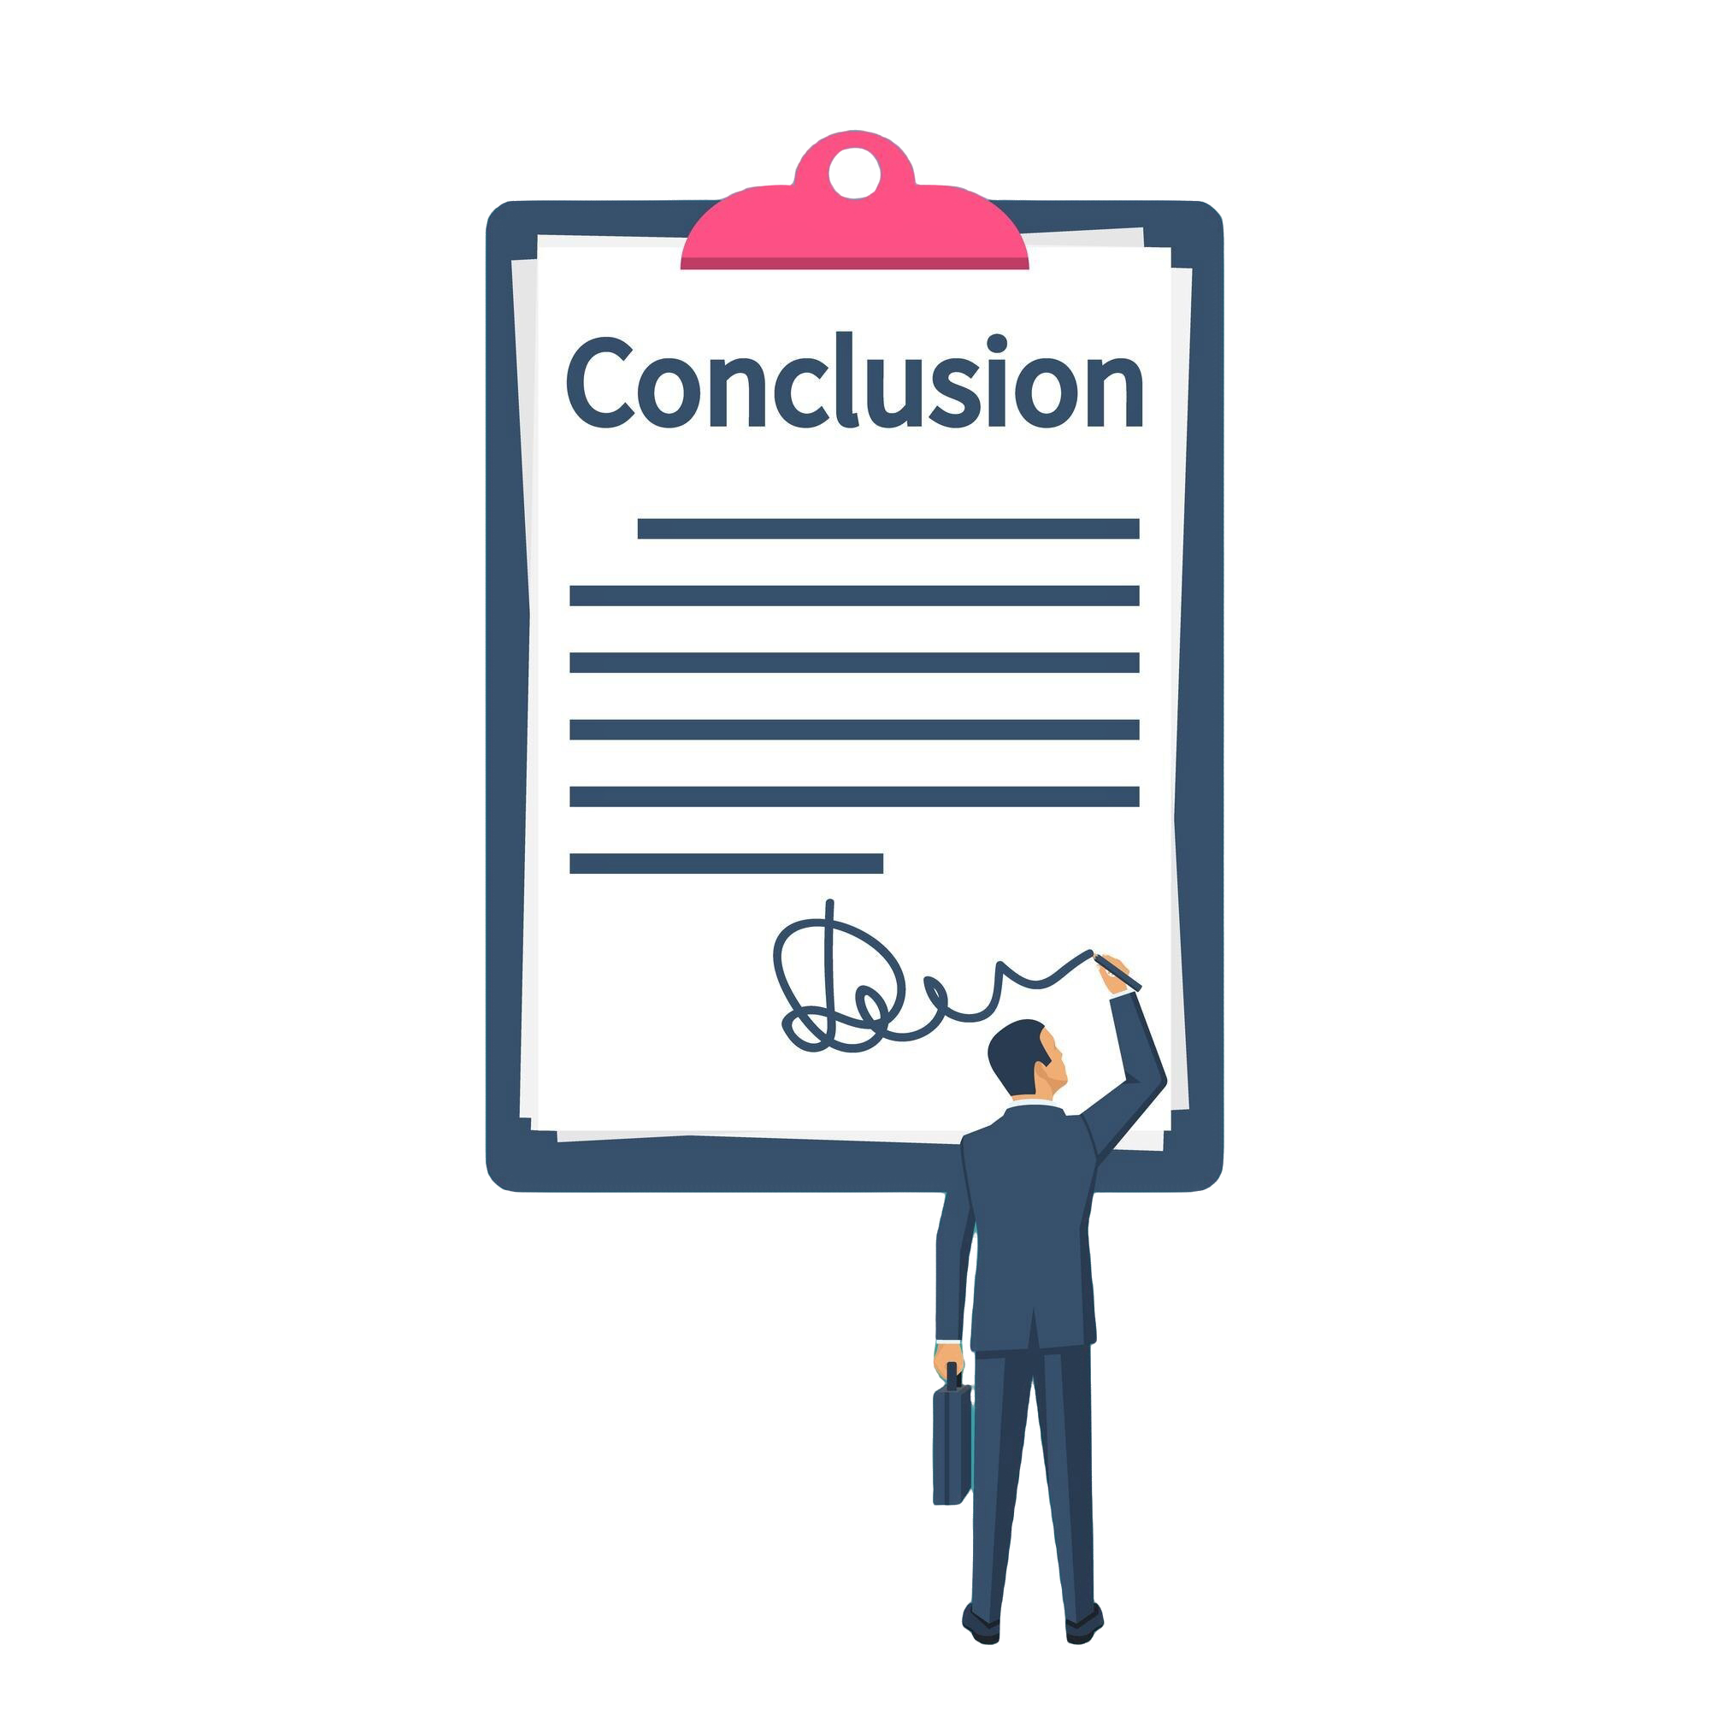
The reactJS knowledge gained via SDGP and industrial placement for building the UI of the system.
The machine learning knowledge gained by the machine learning module was used effectively.
The programming practice and web development knowledge gained by the university.
Conclusion
Use of Existing Skills
New Skills acquired
The machine learning knowledge gained by the machine learning module was used effectively.
The programming practice and knowledge gained at the university.
Advanced deep learning deployment on mobile application
Creating datasets and labeling them
Real time optimization
Notes:
14

